Slide 1
Web Design & Development Y2/Sem 1
Week 5. basic Forms

Slide 2
How are you doing?
Week 5 already!!
MCQ1 completed
MCQ2 – 15/16th October
MCQ on Weeks1 to 5 – 22/23 October
Project wireframes – Week 7 - 4th November
This is a tough semester for you – with lots of project work across modules

Slide 3
Typical form interaction
User account on website
Register/signup, login, forgot password
Personal details, Payment details, Delivery details
Online shopping
Payment page, checkout page
Filtering content
Dropdowns, checkboxes, radio buttons
Search
Search box
Uploading files
Uploading assignment to Moodle, change profile image on social media site

Slide 4
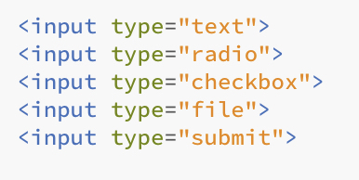
Form controls
Type of controls
text inputs (for one or multiple lines)
radio buttons, checkboxes. dropdowns
File upload
submit buttons
Some of the above use the <input> tag – this is defined by the type attribute. We will see this attribute used later to define different types of input from the user

Slide 5
Making form completion easy
Field labels – what the input field is for?
Displayed above the input field – rather than to the left
Help text – any special instructions for entering value
Placeholder – displayed in the input field
or displayed above or below the input field
Input validation/feedback
Highlight errors to user during or after form submission
What fields are invalid and why
Failure in submission/feedback
What was incorrect? Why was the submission unsuccessful? What can I do to resolve?
Successful submission
What happens next? What should I expect? Do I need to do anything else?

Slide 6
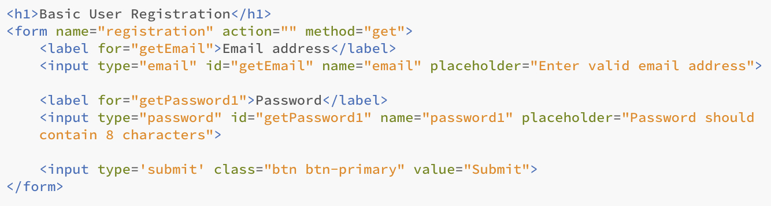
Basic example
Basic example of user registration (looking for email address and password – gives us a simple starting example to look at the key parts of any form

Slide 7
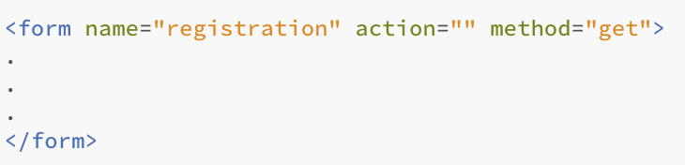
<form> element
<form> defines an interactive area of a web page which contains controls
Controls are input text, radio button, check boxes, button (submit/cancel) etc.
All form controls must appear within the starting <form> and ending </form> tags
When a form is submitted to a server – only the controls that are exist within the form can be processed.

Slide 8
<form> element
<form> attributes
Name – the name of the form
Action – what page to send the form-data when the form is actually submitted. Can be omitted if same page.
Method – GET or POST; if omitted default is GET
GET – form data name/value pairs sent in the URL of the GET request
POST – form data name/value pairs sent in HTTP request

Slide 9
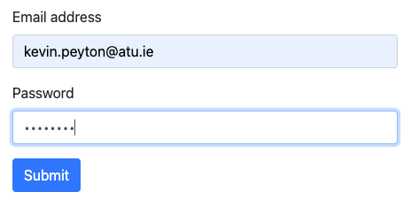
<form> element
Using GET method
Address bar at top of browser – name/value
pairs from form are available to view
Click submit

Slide 10
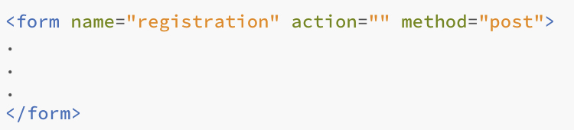
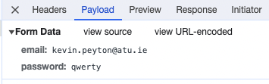
<form> element
Using POST method
For below In Chrome – via developer tools, choose “Network, click on page being viewed and “Payload” .
Click submit

Slide 11

Form inputs need <label>
Form inputs (text input fields, checkboxes, dropdowns etc) – are preceded by a <label>
Visual cue for user – what the field for
<label> is a semantic element, should only be found in <form> element
<label> is paired with a specific form control through the for attribute matching the id attribute of the related input element
Best Practice : Labels should be above the field they relate to

Slide 12
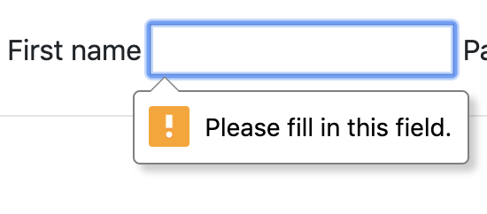
Some <input> attributes
The relevancy of some of these attributes depend on the type attribute of the input field
Example of an input text field called ”firstname”
maxlength attribute: specifies the maximum length of the data the user can enter
required attribute : if no value entered and form is submitted – browser will throw error

Slide 13
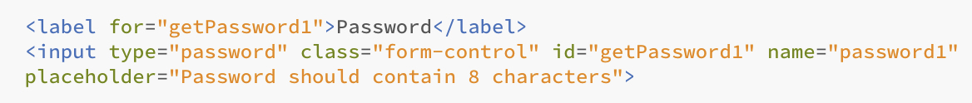
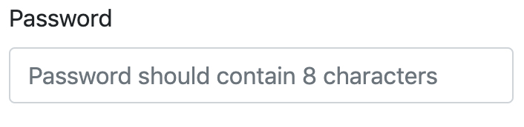
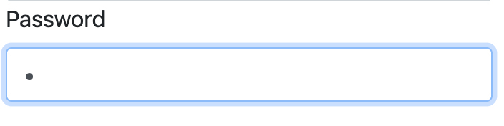
Placeholder attribute
placeholder attribute allows hint text to be added to a text input field
HTML5 element – fully supported across browsers
Disadvantage – disappears on entering data
Alternative - add help text above or below input field – always remains on screen
hint text disappears when user enters data into field

Slide 14
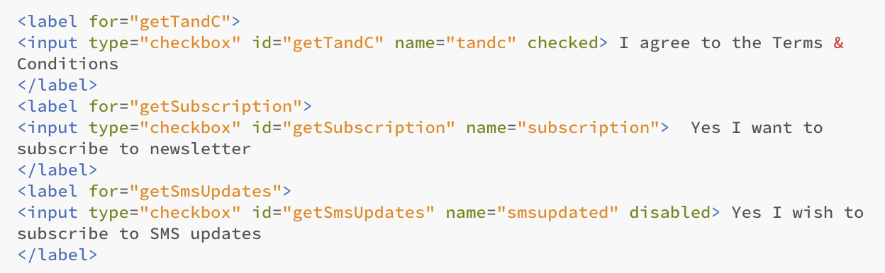
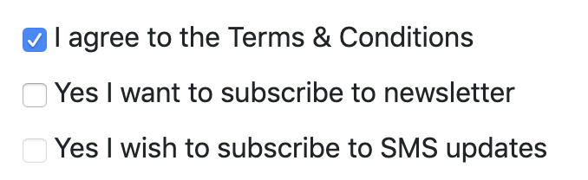
<input> check boxes
Wrap checkbox in a label – easier for user to check field
checked attribute– makes the field checked by default
disabled attribute – usable for all form elements. Disallows user from entering information in that field
Question : give an example/context of using required attribute on checkbox

Slide 15
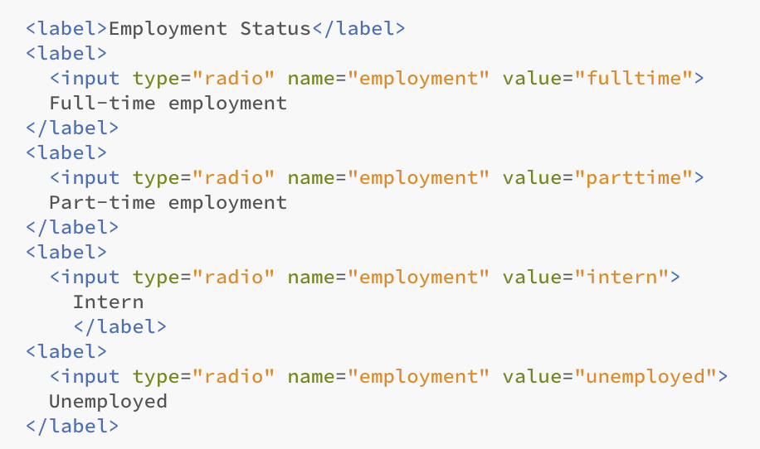
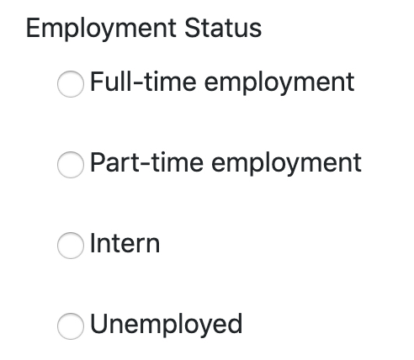
<input> radio buttons
Radio buttons are mutually exclusive - only one with the same name is selectable
checked attribute is usable

Slide 16
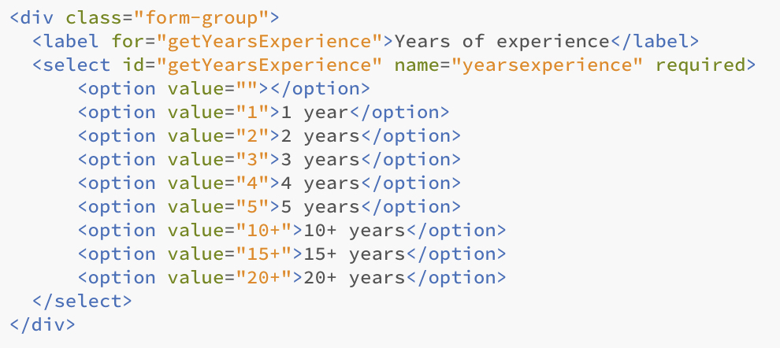
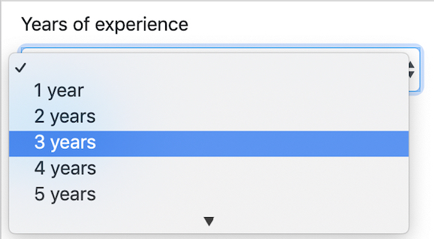
<select> element
Known as selects, combo boxes, drop downs
multiple attribute– allows many options to be selected (ctrl + click)

Slide 17
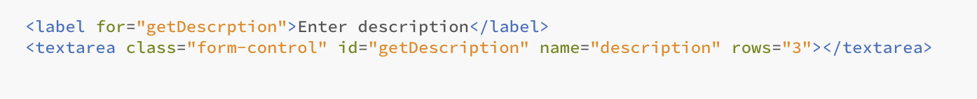
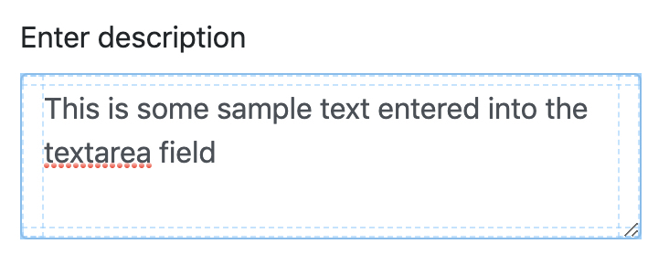
<textarea>
Multi line text box – increase rows attribute to increase height

Slide 18
Getting values from a form – we will cover this in future tutorial..
For basic project purposes – we will use Javascript to store/process data from forms using the following basics.,
Javascript object to get data from forms
console.log() to push data to browser developer tools (console view)
console.log( formValues );
localStorage web object to store session information
localStorage.setItem(’petName', ‘Rover’)); // call this in petname.html
var petName = localStorage.getItem(’petName'); // retrieve in mypets.html – different page
JSON call to convert Javascript arrays to string name value pair
localStorage.setItem('regForm', JSON.stringify(formValues));
JSON call to convert JSON string back to Javascript array
var formValues = JSON.parse(localStorage.getItem('regForm'));

Slide 19
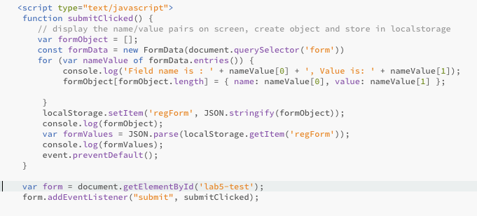
This code called from the bottom of your html file – could be also loaded as customjs\project.js or similar ☺

